Slide 1


Basic Legal Citation Presentation 1
Presented By
Harish Sethumadhavan
Brenda Olivia Martis
Joao Curcio

Slide 2
The Team
Akshay Tata at758
Aiswarya Jami aj493
Brenda Olivia Martis bom6
Devi Snigdha Muppala dm754
Harish SethuMadhavan hs643
Joao Curcio jfc293
Sania Nagpal sn579
Yihui Fu yf263
Notes:
Interrupted for team introduction

Slide 3
Outline
Purpose and Scope
Requirements
Project Progress
Design Alternatives
Proposed Solution

Slide 4
Project Goal / Objective

Slide 5
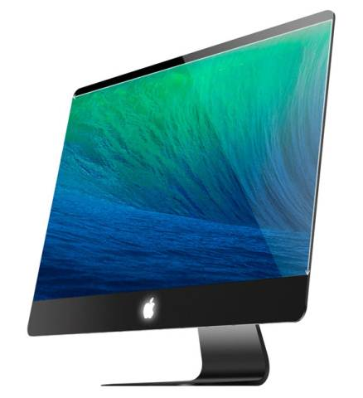
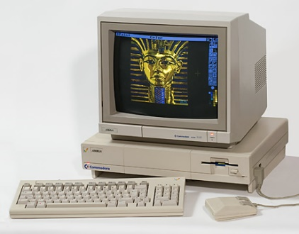
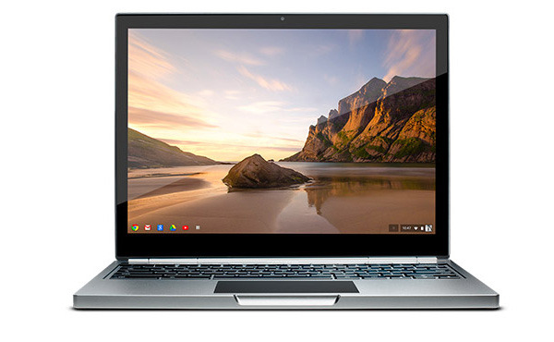
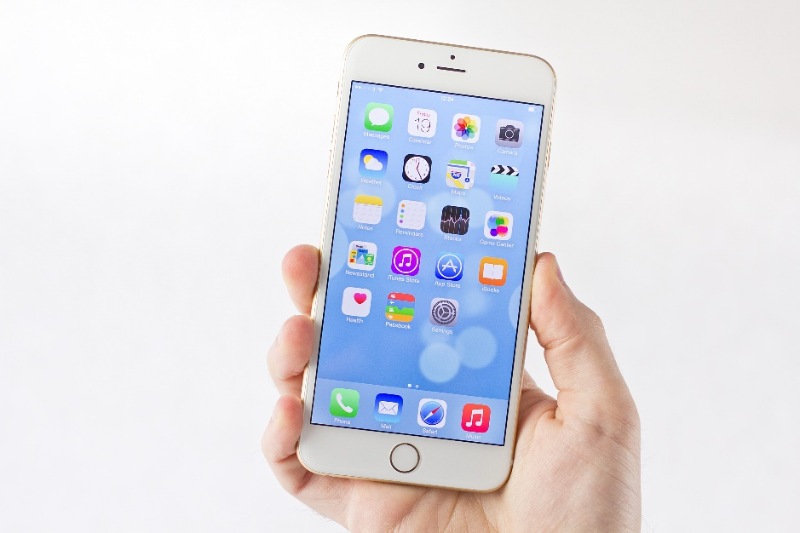
Modernize website
1993
2015
Notes:
Work in 1993. Website in 1994. […]

Slide 6
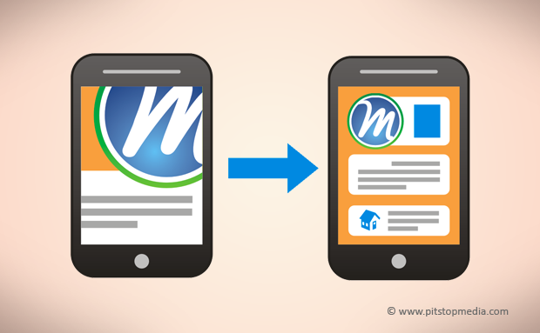
Mobile-friendly
Notes:
Arms confirms if it’s first priority

Slide 7
Easy conversion to all formats
XHTML
Original HTML
EPUB
PDF
MOBI
Notes:
Single source document that can be edited and delivered in all the formats.
Arms: technical difficultys. Are you going to talk about it?

Slide 8
Current Website

Slide 9
Current Website Issues
Website:
Not interactive
Not Mobile-friendly
Conversion to other formats:
Manual

Slide 10

Current Website Issues
Website:
Not interactive
Not Mobile-friendly
Conversion to other formats:
Manual

Slide 11
Requirements

Slide 12
Website Redesign
Mandatory
Redesigning of the content layout
Mobile-friendly
Improve content display
Crawlable (SEO)
Optional
An effective search box
Author’s interface
Notes:
Redesign of the content layout: graphical design
Martin: where does the interactivity falls?

Slide 13
Format Conversions
PDF
EPUB
MOBI
Mandatory
Optional
Notes:
50,000 PDF
1000 epub and mobi
More people using mobi. But Martin is happy that epub is higher.
Arm’s question:[…]

Slide 14
Non-functional Requirements
Reusability and maintenance
Good user experience
Scalability
Consistency
Browser compatibility
Extensibility
Notes:
Consistency: website is more interactive.
PDF permits print of portion on demand.
Arms: requirements got be specific. E.g. Good user experience. Vs Browser Compatibility (better with a list)
Try to avoid vague descriptions

Slide 15
Use case 1
SEARCH
GO
USES A METADATA TO MATCH THE INPUT WITH THE CONTENT
Redirects to the appropriate page that contains
the tags associated with the search
Notes:
Metadata is author applied metadata

Slide 16
Use case 2
DOWNLOAD
DOWNLOAD EBOOK
The visitor selects a book that’s automatically generated to download.
BUY MOBI EBOOK
The visitor is redirected to Amazon.
> PDF
> EPUB
> MOBI
Notes:
Significant purchase for mobi. The buy from Amazon: someone needs to update the supply on Amazon

Slide 17
Use case 3
<content> MANAGE </content>
Uses a strict XHTML markup language, avoiding unsupported tags such as <iframes>
EDIT CONTENT . ADD CONTENT . DELETE CONTENT
Notes:
Dreamweaver?
Arms: First time seeing the XHTML.
How complex is the formats’ schema – A matter putting attributes, semantic

Slide 18
Use case 4
GENERATE EBOOK
Provided a XHTML file, the system will output all the e-book formats from the website.
When the XHTML is published, the e-books are going to be automatically updated in the website.
Notes:
Sylvia: 80 pages of content. 10pages/person

Slide 19
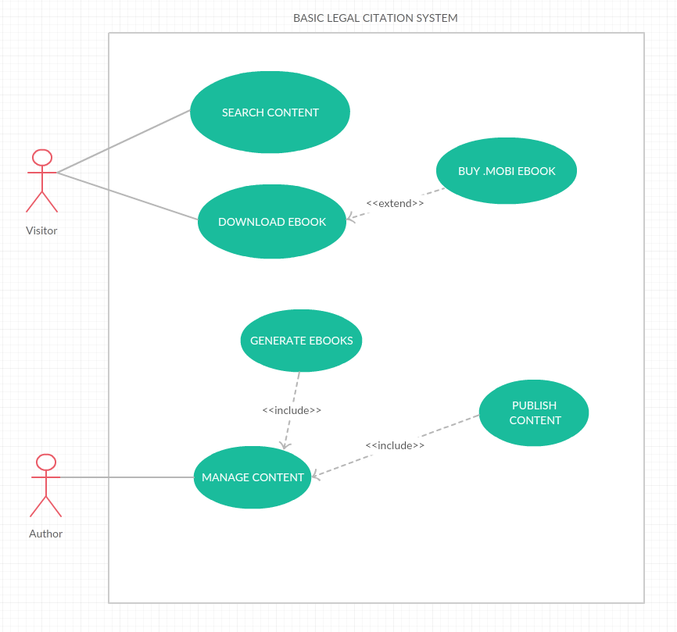
Notes:
Difficult to read: fonts too small. White color in color is really risky

Slide 20
Scenario 1
The author edits a page
Access the server for files
Edit files using our XHTML
Publishes the content
The changes immediately affect the e-books
Notes:
Arms: where does the citation come from?
Not understanding our project

Slide 21
Scenario 2
Visitor wishes to download an e-book
Choose download menu e-books
Choose the format and
Downloads it

Slide 22
Scenario 3
The author wants to generate ePub
Needs a table of content in HTML
Needs metadata, CSS and cover
The system generates them automatically using those files and the website.

Slide 23
Progress

Slide 24
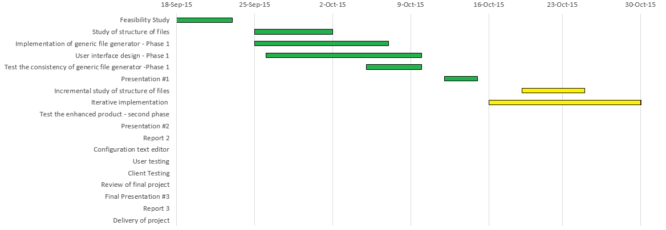
Gantt Chart
Notes:
Fonts too small
Put this in report

Slide 25
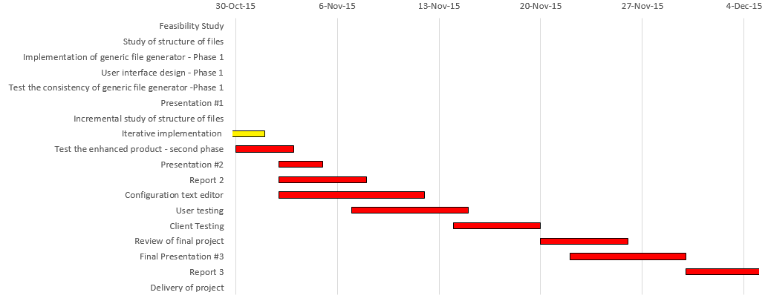
Gantt Chart contd.
Notes:
User testing and client tesitng: doing it too later? Has to be iterative

Slide 26
Tasks completed
First iteration
Interactive, mobile friendly website
Conversion to PDF, ePub

Slide 27
Tasks Pending
XHTML markup
Complete tag search – topical index

Slide 28



Workflow
Uses
Publish
HTML
Author
View/Download
Visitor

Slide 29
Design Alternatives
Html-pdf
https://github.com/sanianagpal/node-html-pdf
Softcover
https://www.softcover.io/
Calibre
http://calibre-ebook.com/

Slide 30
Chosen Solution
Calibre
Convert HTML to PDF
Convert HTML to mobi
Convert HTML to ePub
Notes:
The function of iframe: highlighted example with the particular feature in the pop-up iframe.

Slide 31
Calibre - Demo

Slide 32
Demo of the new website
Notes:
Demo: jumping from windows. Go slowly:” I’m going to…”
Design: follow up with LII existing skin
Confirm with client about the menu hierachy
Martin: other navigation?

Slide 33
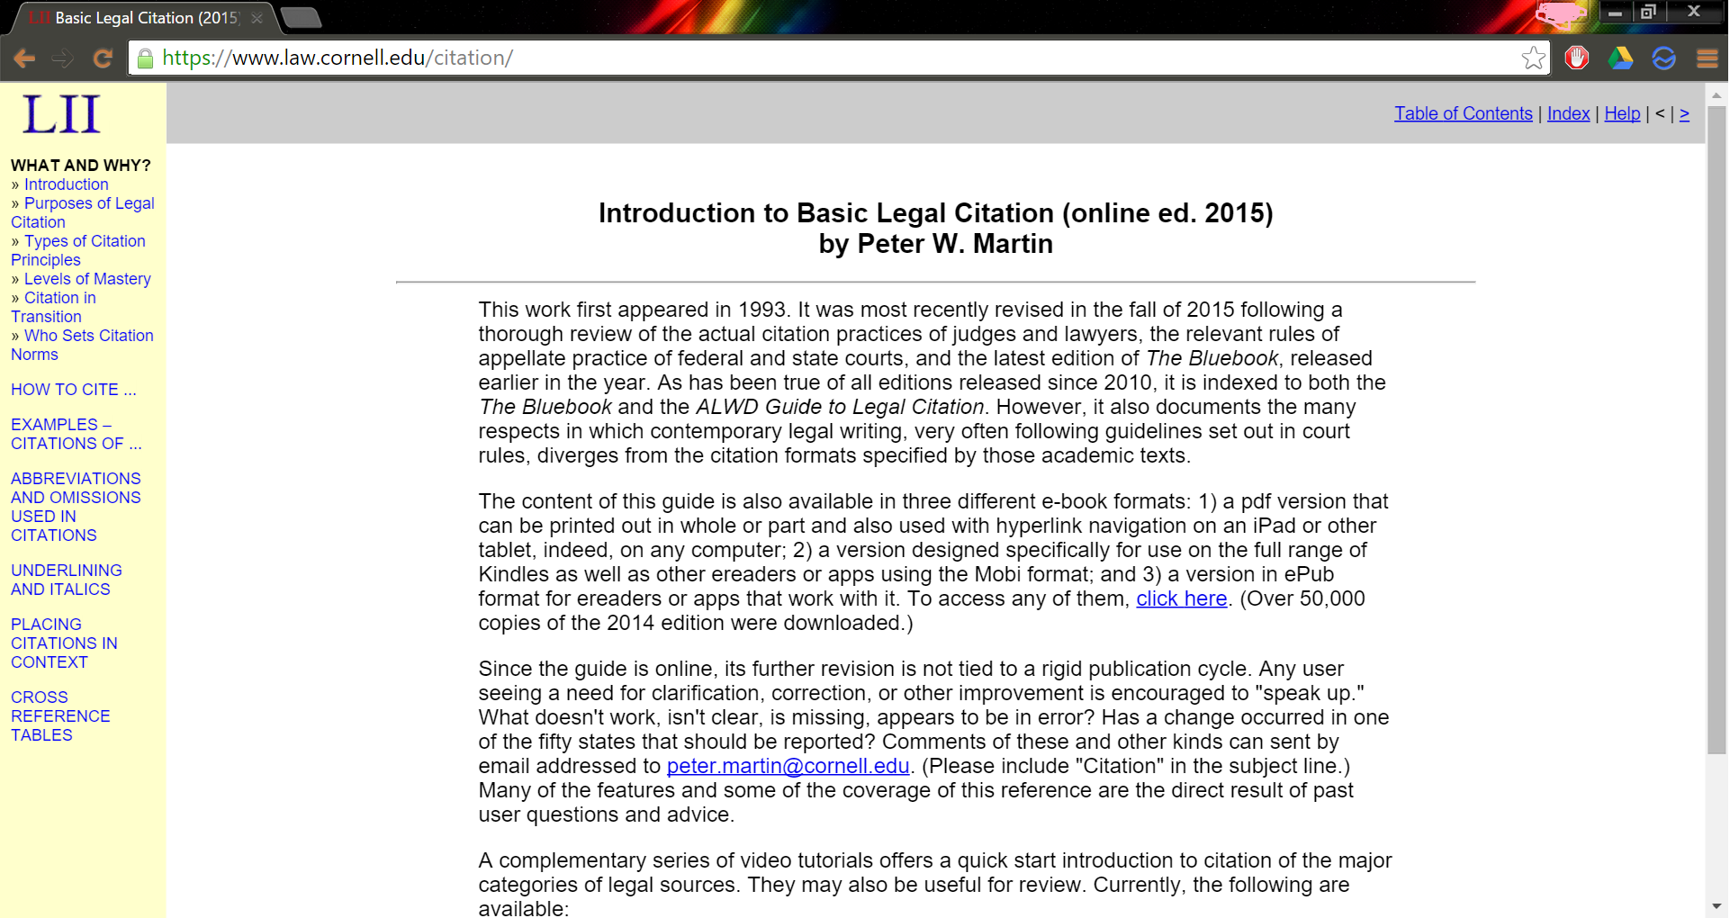
Website revamp

Slide 34
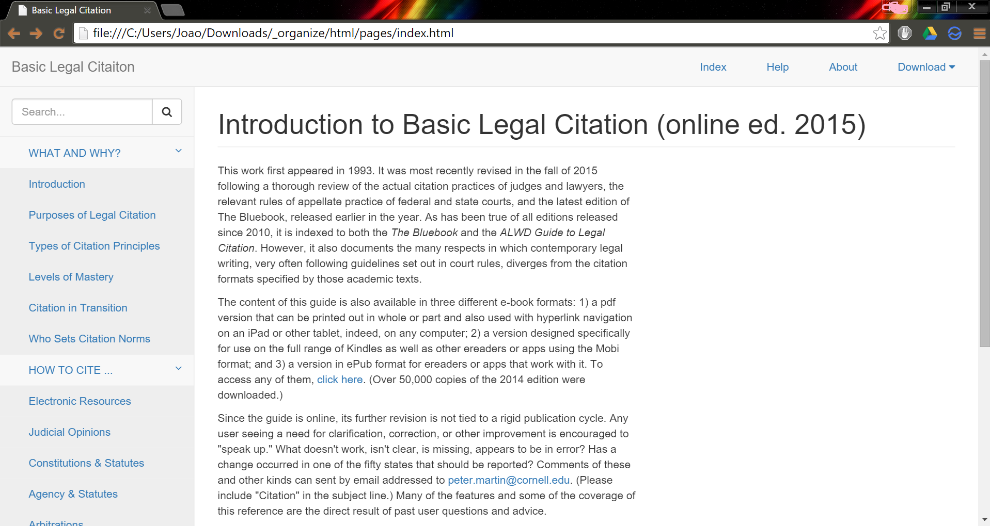
Website revamp

Slide 35

Website revamp

Slide 36
Key features of new prototype
Mobile friendly
Responsive and interactive
Dynamic with Search engine optimization
Search box

Slide 37
Test plan
Generic file generator
Home page
10 levels
Large tables
iframe
Notes:
Large tables are a clumsy way. An interactive can without a large tables.

Slide 38
Test plan contd.
Revamped website
Conversion
Screen sizes

Slide 39
Risks & Problems
Time Constraint
Incompatible HTML tags
XHTML tagging

Slide 40
Q & A
Notes:
Peter:
Might still need tables in static ebooks
Sara:
Interactivty examples: user; author
Metadata search
Table replaced
Not guess, but client experience
Strong progess, capable to finish it
More communications
Slyvia:
More communications. There is something we’ve done that we know not working.
Arms:
Building on an existing system, getting the requirements right is more difficult. Which is the client really want.
A little bit worried about schedule. Time for user testing and making changes
Gantt chart: how to describe the work it’s done. Complete is not complete.
Difficult in userbility and format conversion.
Is converting exsiting html a part of a project. XHTML to HTML.

